Slide 14
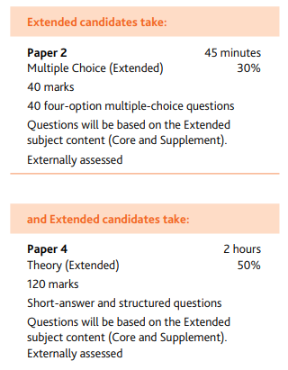
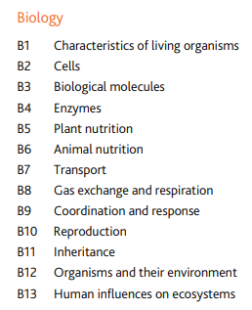
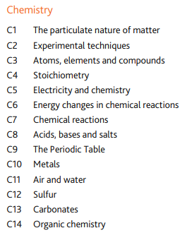
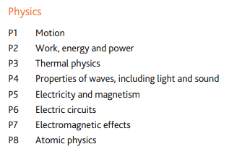
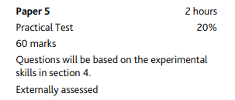
IGCSE Coordinated Science (Double Award)
“The combination of knowledge and skills in Cambridge IGCSE Co-ordinated Sciences (Double Award) gives learners a solid foundation for further study. Candidates who achieve grades A*A* to CC are well prepared to follow a wide range of courses including Cambridge International AS & A Level science subjects.”

Slide 15
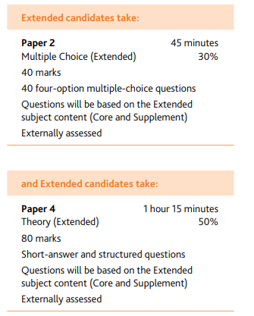
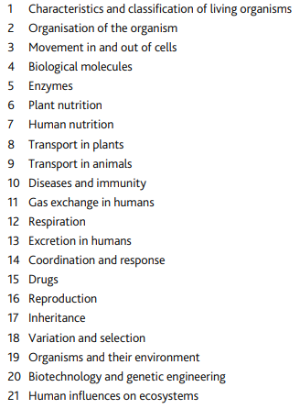
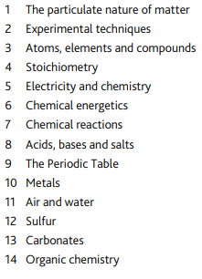
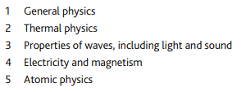
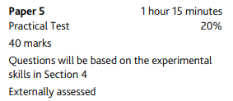
IGCSE Separate Sciences (3 IGCSES)
Students will take 9 exams in total

Slide 16
Which course is right for me?
The Separate Science program is for students that:
Are excelling in Science
Are willing to work hard and at a fast pace
Enjoy science
Are planning to study A Level Sciences
Are planning on pursing a career in the sciences
The Coordinated Science program is for students that:
Might not be as passionate about science
Have lots of other subjects/extra-curricular activities that also interest them
Are considering a science A Level, but are still unsure
Would prefer to take more time over their learning
Would prefer to do less exams

Slide 24
Le français
What happens:
Intensive grammar
5 topics of work
4 exams:
Listening
Speaking
Reading
Writing
Career options with French:
Interpreter
Translator
Teacher
Pilot
Football manager
Footballer (playing in different countries)
Businessperson
Air steward
Chef
Coach
Tour guide
Blogger
Youtuber
Liaison Officer
Writer
Speaker
The list is endless!!!!!!!!!!!
Remember not everyone speaks English in the world and when you can at least try to speak to someone in their own language you are already in their good books.
Why choose French:
Languages develop critical thinking skills
Enriches other subjects
French is the only language, along with English, that is taught in every country in the world
Employability with a language at GCSE level
It’s the language of business especially in Europe
Broadens your cultural knowledge and understanding and meet new people
100% A* - C over past 3 years
100% A* - A for dual linguists past 2 years
Quebec trip

Slide 25
El español
What happens:
Intensive grammar
5 topics of work
4 exams:
Listening
Speaking
Reading
Writing
Career options with Spanish:
Interpreter
Translator
Teacher
Pilot
Football manager
Footballer (playing in different countries)
Businessperson
Air steward
Chef
Coach
Tour guide
Blogger
Youtuber
Liaison Officer
Writer
Speaker
The list is endless!!!!!!!!!!!
Remember not everyone speaks English in the world and when you can at least try to speak to someone in their own language you are already in their good books.
Why choose Spanish:
Languages develop critical thinking skills
Enriches other subjects
4th most spoken language in the world
Employability with a language at GCSE level
Meet new people
It opens up a whole host of countries to visit (especially where we are!)
Broadens your cultural knowledge and understanding
100% A* - A for dual linguists past 2 years
Costa Rica trip

